Slide 1
AUTONOMOUS QUADBOARD

Slide 2

DESCRIPTION
AUTONOMOUS QUADBOARD
People who are completely blind or have impaired vision usually have a difficult time navigating outside the spaces that they're accustomed to.
In fact, physical movement is one of the biggest challenges for blind people, explains World Access for the Blind.
Traveling or merely walking down a crowded street can be challenging.
Because of this, many people with low vision will prefer to travel with a sighted friend or family member when navigating unfamiliar places.
This is where our Autonomous Quadboard comes in handy.

Slide 3
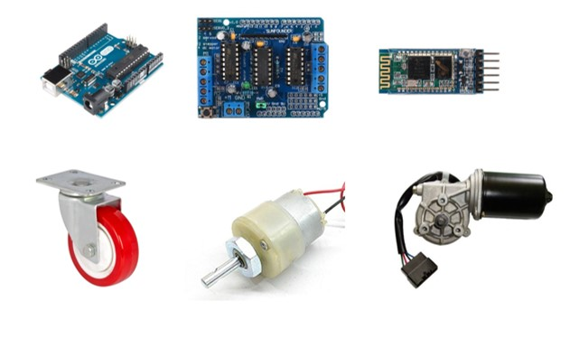
MATERIALS REQUIRED
AUTONOMOUS QUADBOARD
ARDUINO UNO
L293D MOTOR SHIELD
HC05 BLUETOOTH MODULE
50 x 25 ANGLE BODY
50 x 25 WOOD
CASTER WHEELS [2]
300 RPM 12V GEARED MOTORS [2]
LUCAS TVS 12V WIPER MOTOR [2]
12V 7A BATTERY

Slide 4
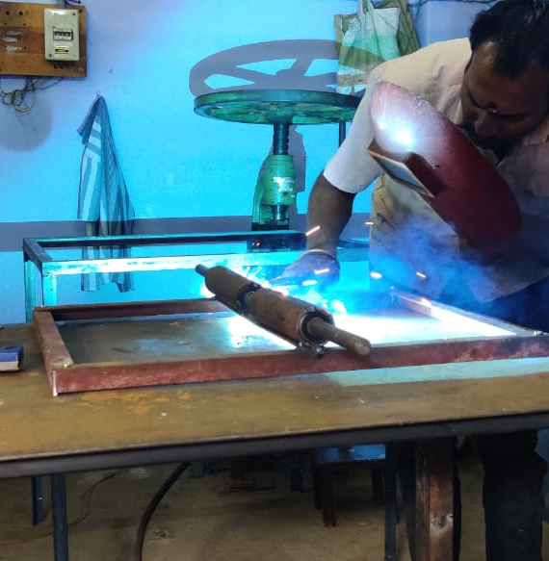
MAKING OF THE QUADBOARD
AUTONOMOUS QUADBOARD
First the angles are welded together and the rollers are placed at the below and are screwed to the body.
A shaft made from ball bearings and cylindrical angles that are placed and welded to move the shaft forward and backward.
Rims are attached to the shaft and the wheels are attached with them.

Slide 5
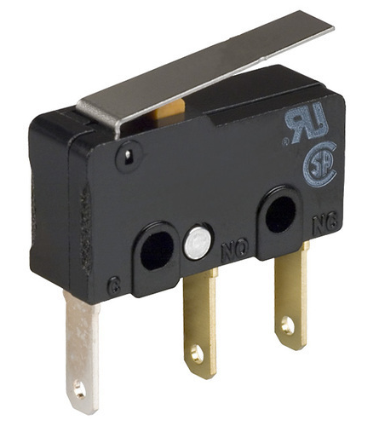
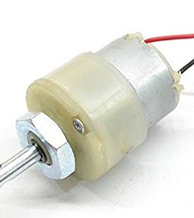
Mechanism of the quadboard
AUTONOMOUS QUADBOARD
Arduino doesn't stand higher voltage. Even though the motor shield is attached with it, it is highly risky that the Arduino is attached directly with the high volt battery.
So, We have developed a different mechanism to run the quadboard using two motors and limit switch.

Slide 6
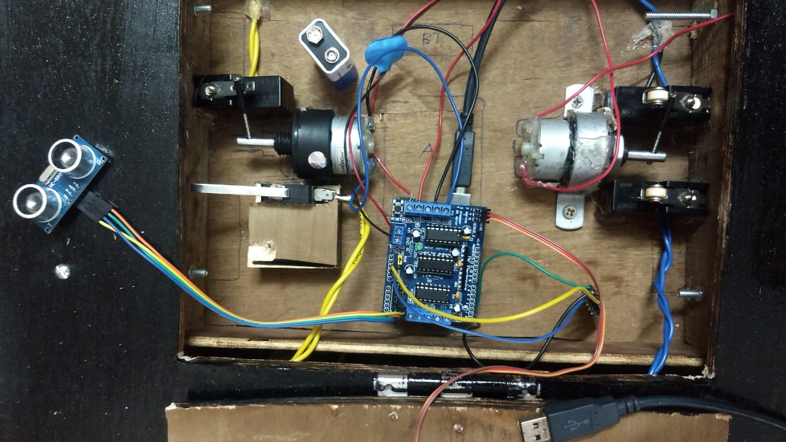
Working of the quadboard
AUTONOMOUS QUADBOARD
This Quadboard is programmed with arduino and it is connected to the mobile phone through the Bluetooth hardware.
Through this Bluetooth hardware the Bluetooth the voice is transmitted to the Quadboard.
The Quadboard is powered by a 12v battery that can be recharged.
The Quadboard is fixed with ultrasonic sensors to avoid accidents and the Quadboard can be moved in any direction

Slide 7
THINGS WE COULD IMPROVE
AUTONOMOUS QUADBOARD
A physical disability is a limitation on a person's physical functioning, mobility, dexterity or stamina. For someone in a wheelchair, even a small step can block their way.
We are planning to make a physically disabled person walk just by using his voice commands

Slide 8
THank you for your time!
AUTONOMOUS QUADBOARD
BALAJI S R
MOHAN PRASANTH
MUKUNDHAN M
NAREN KUMAR V R
PAULSON ROBERT R

